Slide 1
RURAL LABOUR RELATIONS IN INDIA KARIN KAPADIA, JENS LERCHE & T.J. BYRES
Rohit Kumar Sah
Issues in India Agriculture
Instructor : Ishita Mehrortra

Slide 2


Slide 3


Slide 4


Slide 5


Slide 7

Let’s Begin With…
Rural labour are the workers in villages or rural parts of the country i.e. remote part of the country who does not have any source of income other than selling their labours to earn money or piece of bread. They do not possess land or capital and do not have any kind of control over land and capital.
They are solely dependent on daily wages which they gross through working physically engaging full day in the tough physical work. They work in agricultural or non-agriculture occupations in return for wages in cash or kind. Hence they are subjected to a number of miseries and struggles.
In this presentation we will revisit the collection of the outcomes of the Workshop on 'Rural Labour Relations in India Today' held at the London School of Economics (LSE) on 19 and 20 June 1997

Slide 8
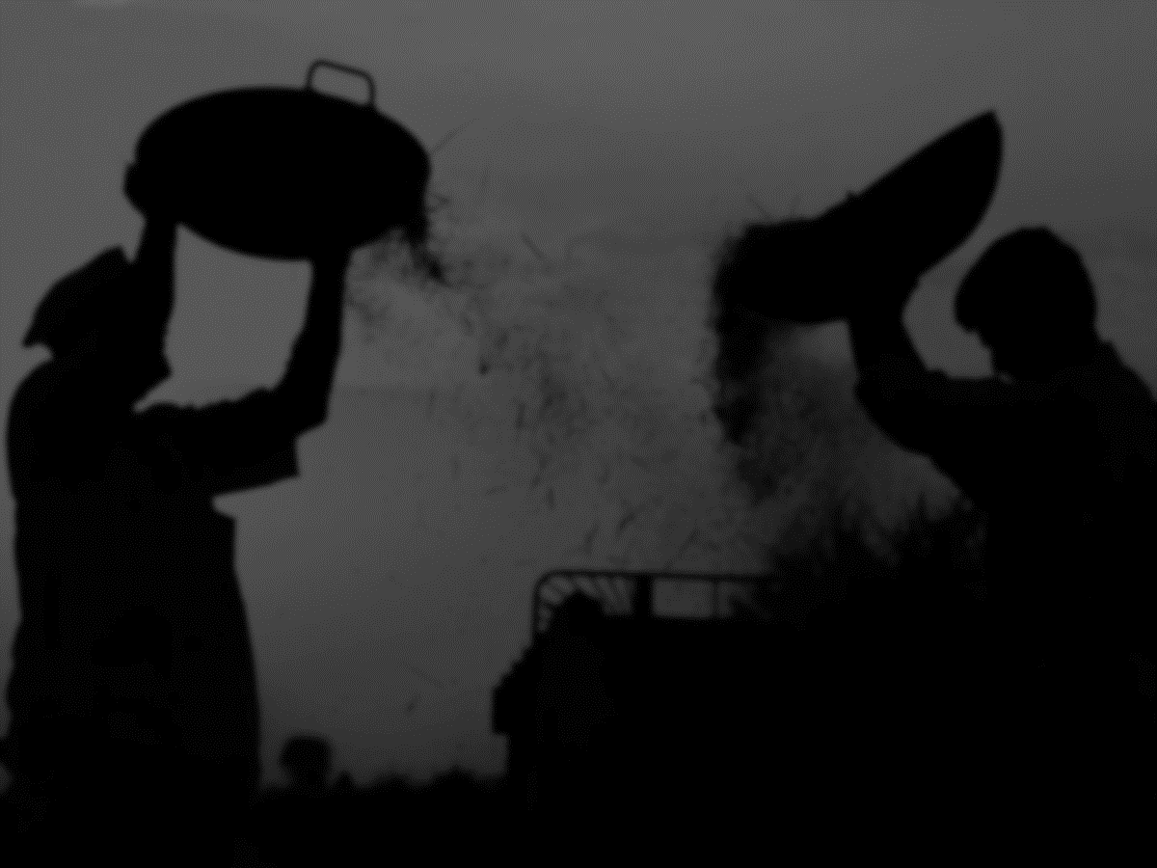
Ideas Of KarIn Kapadia & Jens Lerche
AIM:
To analyse emerging development trajectories of rural labour relations and rural labour struggles in India, based on studies from its regions and states.
To present the case studies focusing on rural labour relations and labour struggles of the 1980s and early 1990s.
To pinpoint all-Indian developments as well as regional differentiation within India
FINDINGS:
Continuous capitalist development in agriculture.
The tightening of the labour market resulting from the increase in nonagricultural employment opportunities.
Emancipatory processes from below.
Collective oppression from above.

Slide 9
Ideas Of KarIn Kapadia & Jens Lerche
When investigating the relationship between labour relations and class struggles, an assessment of the forms and outcomes of class struggle from below and class struggle from above in different Indian regions and states becomes essential. Disagreements exist within the academic community.
Two aspects of the closely linked themes were of special interest to the organisers, namely that of the emancipation of rural labourers and that of gendered changes in labour relations.
The central question that is raised by an analysis of changing labour relations is how to conceptualise a sociologically nuanced and disaggregated analysis of capitalism in rural India today. The analyses provide an insight into the main issues of labour relations within different regions and contribute to our understanding of contemporary Rural Labour Relations in India.

Slide 10
Views Of T.J. Byres
T.J. Byres had concentrated on the papers from the conference published on the special issue mentioned by Kapadia and Lerche. His aim is threefold:
To identify and consider the major persistent themes.
To distinguish, within those themes whatever common processes with respect to labour relations in the Indian countryside, can be observed in the contributions published.
To suggest what the accounts reveal about differential outcomes within the Indian social formation.

Slide 11
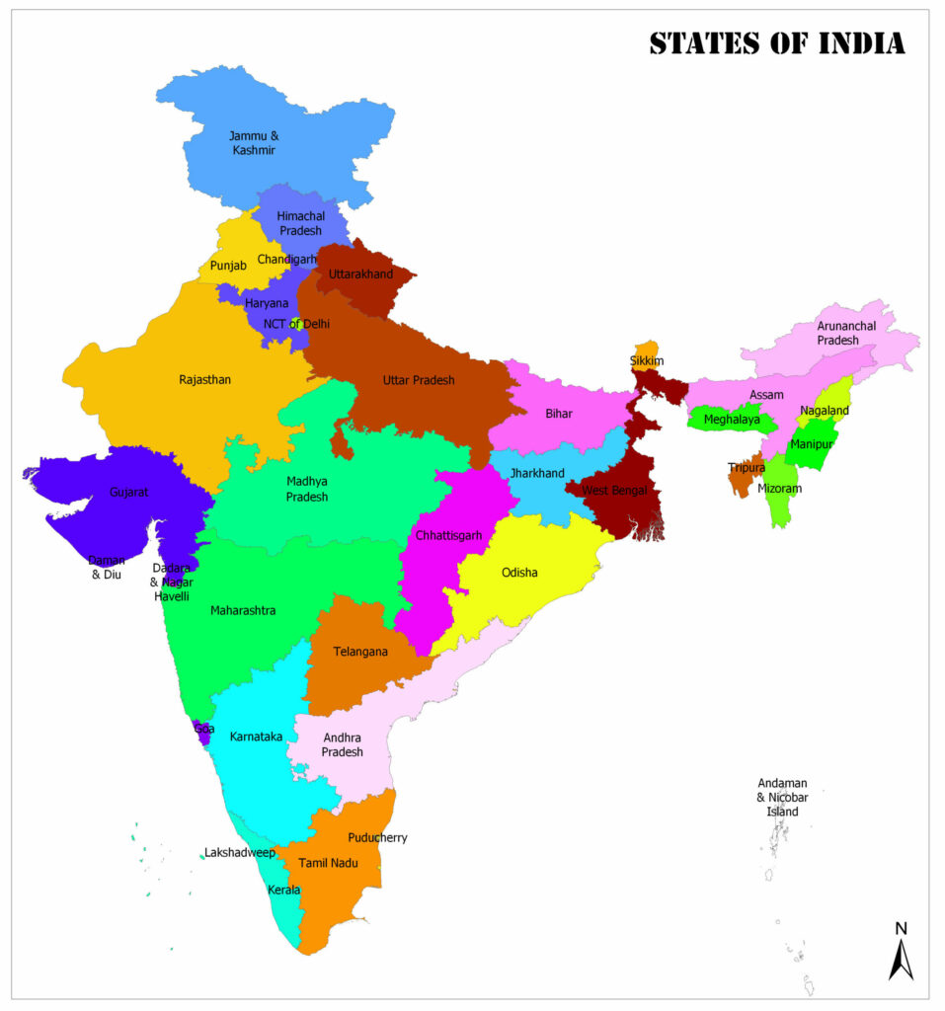
I
N
D
I
A
N
S
T
A
T
E
S

Slide 12
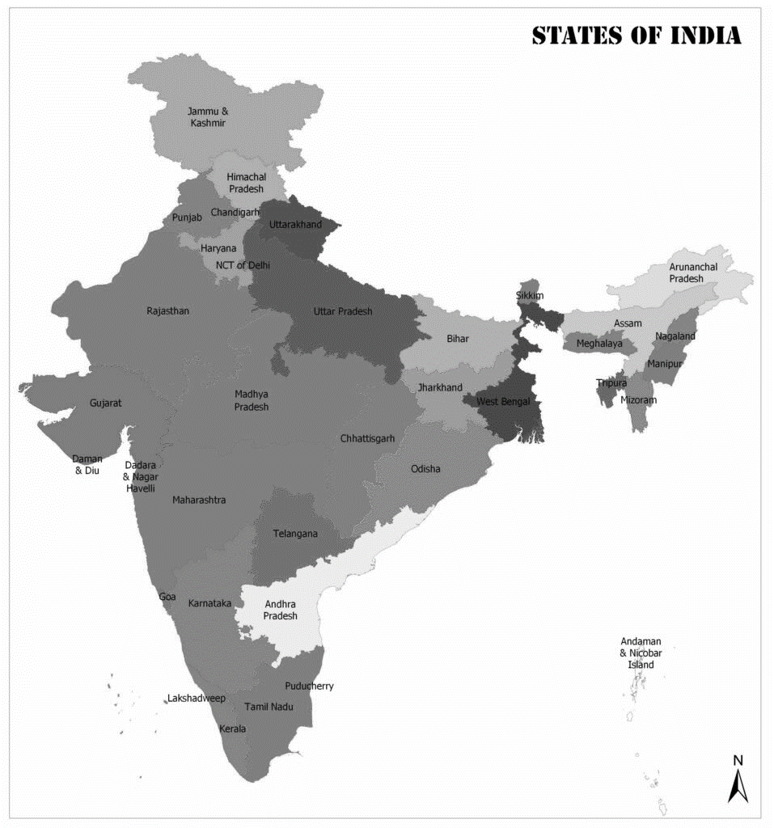

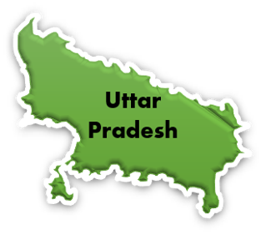
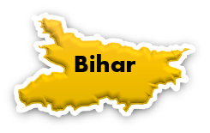
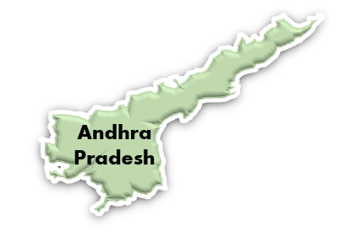
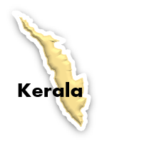
I
N
D
I
A
N
S
T
A
T
E
S

Slide 13
I
N
D
I
A
N
S
T
A
T
E
S

Slide 14

KERALA
Kannan points out the features of Kerala as –
Uniqueness among Indian states.
Human dignity and social progress is remarkable.
The emergence of trade unions as a strong labour institution and the overall social progress.
A sustained increase in wages
These are undeniable achievements.

Slide 15
KERALA
Role of State :
Kannan argues that the state in Kerala is a 'soft institution’. Kannan holds that in Kerala poverty alleviation programmes played a prominent part in the 1980s in maintaining the gains made previously by agricultural labourers: stemming the immiserisation that had taken place in the 1970s.
Limitations inherent in emancipatory process:
Kannan feels that Kerala is the state where emancipatory processes have gone furthest in India. He describes a process of social development without a commensurate transformation of the productive forces giving rise to a central dilemma faced by Kerala - that of technological progress being blocked, and accumulation being slowed down significantly, by militant agricultural labour.

Slide 16
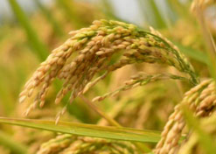
Andhra Pradesh
Corta and Venkateshwarlu show an important improvement in the economic position of labourers in several respects:
A decline for men in traditional, permanent bonded relations and significant increases in real agricultural wages for both men and women.
Among the obligations contested by men are low/unpaid ploughing/irrigation tasks, beck-and-call arrangements, and the denial of their right to seek better paid work elsewhere, in the process either shirking or refusing work.
Again, this achievement is undeniable.

Slide 17
Andhra Pradesh
Role of state:
In the contribution by Corta and Venkateshwarlu state interventions are given some prominence. They tell us that some policies had a direct and fairly strong impact on male labourers economic position, such as the 1969 policy of opening up formally restricted government wasteland for use by landless labourers .
Limitations inherent in emancipatory process:
Corta and Venkateshwarlu identify what they term a 'Standard of Living Paradox' in Andhra Pradesh, which translates into the proposition 'that despite a near doubling of real wages since 1970, food consumption levels and general standard of living were lower than expected and this is reflected in a heavy dependence on employers and merchants for exploitative loans’.

Slide 18
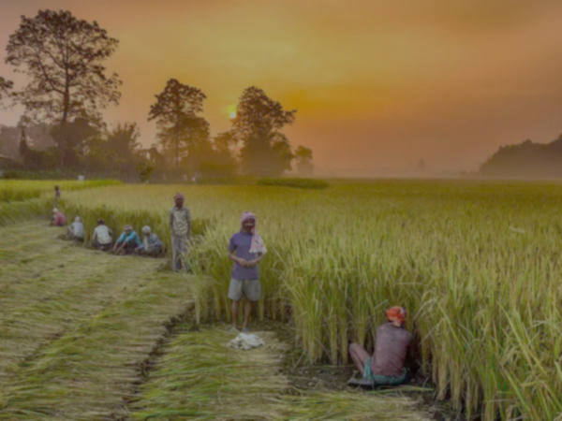
Uttar Pradesh
For Uttar Pradesh, Srivastava documents an active struggle between landless labourers and Jat landholders, which has had a notable outcome.
He demonstrates a clear increase in class consciousness and in class-for-itself action, including strikes, by landless labourers, and action, moreover, which has had considerable success.
While conflict and struggle between the poor and dominant classes has never been absent from the rural scene in Uttar Pradesh, evidence examined in this study suggests that recent changes may have added new dimensions and assertiveness to the poor.
Class struggle has secured clear gains for rural labourers.

Slide 19
Uttar Pradesh
Role of State:
In Uttar Pradesh, Lerche lays considerable stress on the extraordinary development in UP in the 1990s, whereby low caste BSP governments have actually been voted in and argues that this has been a catalyst for many of the positive changes that have taken place for rural labourers
Limitations inherent in emancipatory process:
Srivastava cautions saying that we might be carried away by romantic notions, but the evidence that demonstrated might be the limited nature of the organisation and absence of sustained mobilisation among the poorer classes in the study areas. Lerche also expresses some caution pointing out that landowners in Uttar Pradesh in the 1990s continue to use 'harsh and direct means of oppression to maintain a cheap, reliable and docile labour force'.

Slide 20

Bihar
Wilson considers the struggle of landless labourers and small cultivators.
He finds that an initial spurt of capital accumulation among a section of larger landowners employing wage labour provided the catalyst for the emergence in the late 1970s of an organised movement of mainly dalit agricultural labourers.
This movement has continued to develop despite a subsequent slowing down of the process of accumulation in agriculture in the face of constraints rooted in the agrarian structure itself and the nature of State power in Bihar.

Slide 21
Bihar
Role of State:
We see a far less positive role of the state in Bihar. There are no positive role of poverty alleviation programmes mentioned by Wilson.
Limitations inherent in emacipatory process:
Wilson reminds us of the continuing stranglehold of the dominant classes over rural society in Bihar, now deploying criminal gangs against landless labourers.

Slide 22
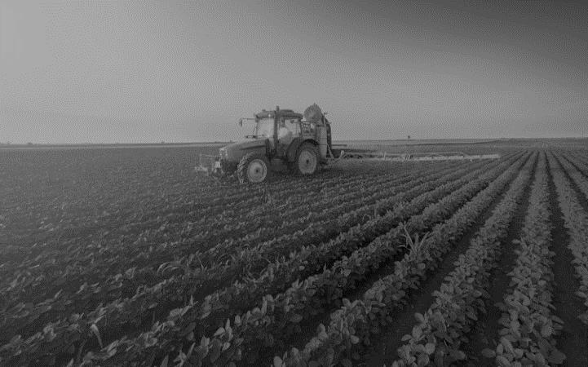
Haryana
Agricultural labourers would appear to have been least assertive in Haryana, one of the most agriculturally prosperous and dynamic of all Indian states.
Here we may identify a divergent element.
It is unique in the timing of militant farmers' agitations, which took place in Haryana during the 1990s, whereas elsewhere in north and north-west India these peaked a decade earlier.
Those militant farmers' agitations were pursued in the name of all peasants and agricultural labourers, yet to the extent that they were successful they were very predominantly so for rich peasants and capitalist farmers.
Indeed, in rural Haryana dominant classes have gained remarkable control over labour processes, remarkably because it has been so weakly contested.

Slide 23
Haryana
Role of State:
In Haryana, Bhalla stresses that it is noteworthy that whatever victories were won, were won largely through the intermediation of governments - central, state or local. No major agricultural workers' union victories were recorded in Haryana which emerged from direct confrontations of agricultural labourers with their employers’.
Limitations inherent in emacipatory process:
In Haryana, the fieldwork villages the main breadwinners had de-linked themselves from all but the most profitable peak season processes in agriculture, and it might be that they were not particularly concerned about the unfree character of many of the slack season labour relations as these relations did not concern them personally. If this is the case, then any further struggle against unfree labour relations awaits initiatives by or on the part of female labourers.

Slide 24

Key Takeaways
This ideas alerts us to the significance for a massive social formation such as India, of not collapsing the regional into the general.
We must seek to avoid both the simplistic explanation and the sterility of empiricism. The former abdicates adequate historical analysis and serious political economy treatment, in terms of processes of class formation and class action; while empiricism takes one no further than the proposition that there is regional diversity.
We got a vivid picture of historical changes and regional variations.
The strong conclusion which can be drawn from them is that this is a primary analytical task facing scholars of rural India. A full set of accounts on the states of India, of the quality of those published here, would allow such a task to begin to proceed seriously.

Slide 25
THANK YOU

